Slide 1
Insurance Renewal Prediction – Group 12
Ishika Gupta (2024AIML088)
Thrilok Attota (2023AIML120)
Namratha S Hegde (2024AIML118)
Yaswanth Reddy Dasari (2024AIML010)
Akash Mohanty (2024AIML133 )

Slide 2
What We’re Solving
The Need For insurance companies, renewals are the foundation of consistent revenue and long-term relationships. Securing renewals ensures both financial stability and stronger customer loyalty.
The Challenge Renewal decisions are often uncertain, influenced by many subtle factors that are hard to anticipate. This unpredictability leads to lost opportunities, declining retention, and weakened trust.
The Approach By applying machine learning to historical patterns, insurers can move from reactive guessing to proactive prediction. This data-driven perspective provides a clearer understanding of renewal behavior.
The Result With reliable predictions, insurers can act early, strengthen engagement, and improve overall retention. This leads to healthier customer relationships and sustainable business growth.

Slide 3
Insurance Renewal – Overview
The Foundation
Renewals are the backbone of insurer revenue and growth
Retaining customers is more cost-effective than acquiring new ones
The Challenge
Renewal decisions are uncertain and influenced by many factors
Missed renewals cause revenue loss and weaken customer trust
Why It Matters
Predicting renewals helps engage at-risk customers proactively
Strong renewal rates build loyalty and ensure business sustainability

Slide 4
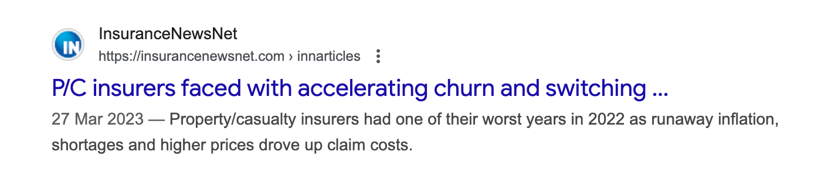

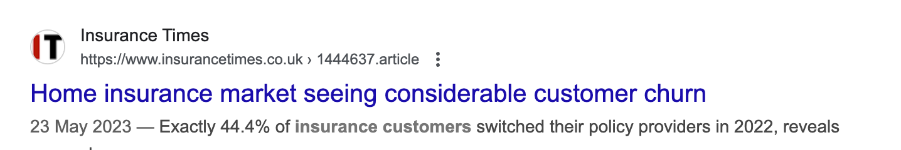
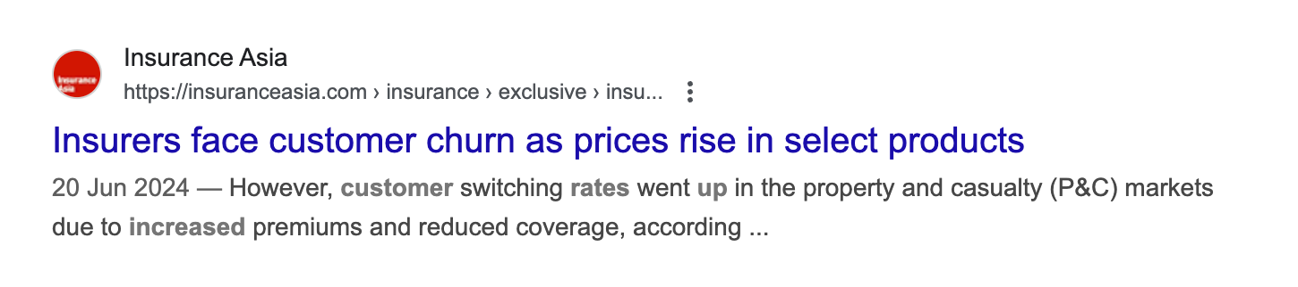
Industry Evidence

Slide 5
The Aim
To build a machine learning–based system that predicts the likelihood of customers renewing their insurance policies, enabling proactive engagement and improved retention.
The Roadmap
Gather and structure historical customer and policy data
Engineer meaningful signals to capture behavioral and transactional patterns
Explore and analyze renewal trends through data visualization and EDA
Build and evaluate predictive models (Logistic Regression, Random Forest, XGBoost, Neural Networks)
Compare model performance using metrics like Recall, F1-score, Precision, and PR-AUC
Identify key factors influencing renewal decisions through feature importance and explainability methods
Provide actionable insights for retention campaigns and customer communication strategies
Validate predictions through pilot testing with real customer segments to assess business impact
The Outcome
Reliable predictions of renewal likelihood
Early identification of at-risk customers
Data-driven strategies for retention and engagement
Strengthened customer trust and sustainable business growth

Slide 6
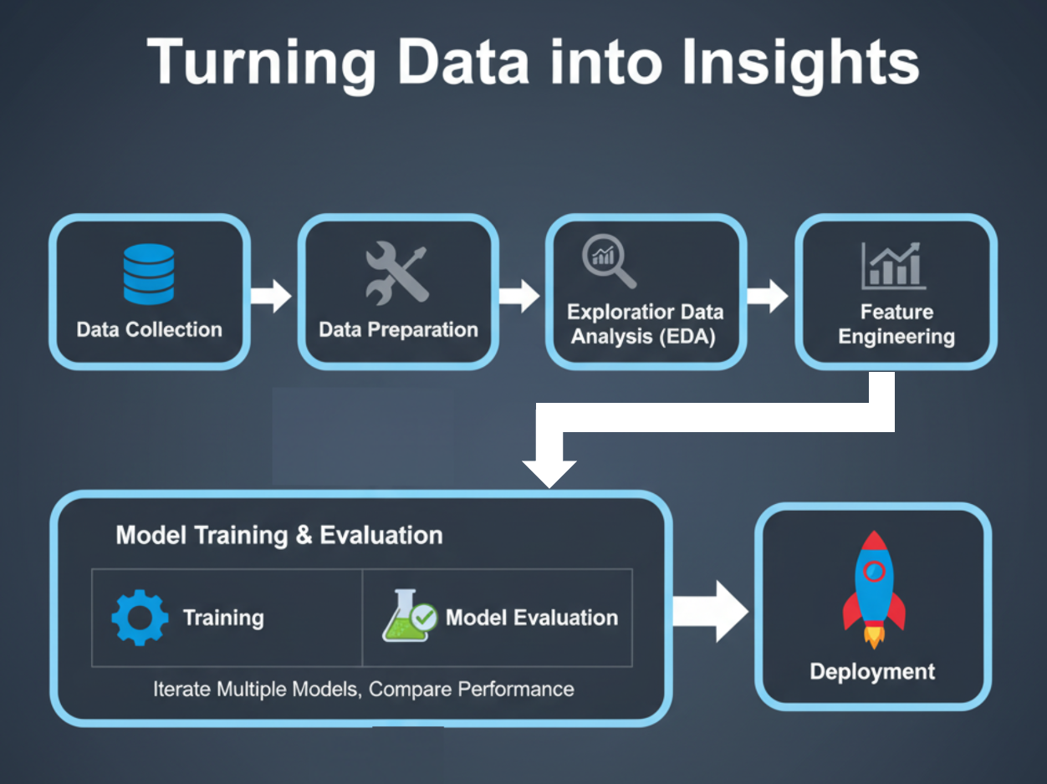

Slide 7
Scope & Status
✅ Work Completed
Data Loading and Preparation
Imported customer and policy datasets
Performed sampling and balancing
Data Preprocessing
Corrected data types
Handled missing values
Detected and treated outliers
Encoded categorical variables
Addressed class imbalance
Exploratory Data Analysis (EDA)
Visualized renewal trends
Performed correlation analysis
Identified key influencing variables
Feature Engineering
Derive new variables
Transform behavioral data into model-ready features
🚀 Next Steps
Data Readiness for Modeling
Finalize train-validation-test splits
Ensure scaling/normalization if required
Model Development & Tuning
Train and evaluate models (LogReg, Random Forest, XGBoost, Neural Nets)
Cross-validation and recursive feature elimination
Feature importance and explainability (e.g., SHAP)
Hyperparameter tuning and optimization
Model Comparison & Reporting
Compare models using Recall, F1, Precision, and PR-AUC
Select best-performing model
Document findings and business insights

Slide 8
Influencing Factors
Category | Features | Dtype
Customer Demographics | age_in_days, Income | Numeric
Payment Behavior | perc_premium_paid_by_cash_credit, Count_3-6_months_late, Count_6-12_months_late, Count_more_than_12_months_late, no_of_premiums_paid | Numeric
Risk & Underwriting Factors | application_underwriting_score | Numeric
Policy Attributes | premium | Numeric
Distribution & Geography | sourcing_channel, residence_area_type | Categorical
Target Variable | renewal | Binary

Slide 9
Missing but Important Renewal Factors
Factor | How it Influences Renewal
Claim History | Frequent or large claims may reduce renewal likelihood due to higher perceived risk.
Type of Insurance | Renewal behavior differs across product lines (e.g., health vs. motor vs. life).
Gender & Marital Status | Demographics can shape risk appetite and renewal decisions.
Policy Add-ons & Riders | Extra benefits improve stickiness and increase renewal probability.
Customer Satisfaction | Poor service or unresolved complaints drive non-renewals.
Competitor Switching | Availability of cheaper/better alternatives can cause churn.

Slide 10
Technical Setup
Operating System – Windows / Mac
Development Environment – Jupyter Notebook (Python)
Libraries Used – scikit-learn, pandas, matplotlib, imbalanced-learn
Dataset Source – Kaggle: Insurance Renewal Prediction (LazyPredict)
Dataset Type – CSV flat file (~80k records, mix of numeric & categorical features)
Version Control – GitHub repository: PredictMyPolicy

Slide 11
Loading and Reading Dataset
Dataset from Kaggle (~80k records)
Identified target variable: Renewal (binary 0/1)
Reviewed feature composition: numeric (age, income, premium, late counts) &
categorical (sourcing channel, residence type)
Performed initial analysis:
Dataset size and structure (~80k records)
Target variable validation (renewal = 0/1)
Feature type verification (numeric & categorical)
Missing values check
Duplicate records check
Invalid or inconsistent values check (e.g., “Urban” vs “Urbn”)

Slide 12
Data Preprocessing & Transformation
1. Dropped irrelevant column (id)
The id column is only a unique identifier.
It does not carry any predictive power for renewal.
Keeping it could mislead the model into finding false patterns.
2. Converted age_in_days → age_in_years
Days are too granular and less interpretable.
Years are more meaningful for business understanding (young vs mid-age vs senior).
Helps in creating age groups/buckets if needed (e.g., 20–30, 30–40).
3. One-hot encoding for categorical features (sourcing_channel, residence_area_type)
ML models (like Logistic Regression, XGBoost) need numeric inputs.
One-hot encoding converts categorical variables into binary indicators (0/1).
Preserves information without introducing ordinal bias (e.g., channel A ≠ channel B, but both get their own dummy variable).

Slide 13
Missing Value Analysis
Late Payment Features (Count_3–6m, Count_6–12m, >12m)
Always missing together → suggests systematic missingness, not random.
Likely indicates “no late payments” → imputed with 0.
Since these features are highly predictive, care taken not to remove variance with blanket imputation.
Application Underwriting Score
Continuous risk score influenced by income, premium, age, and number of premiums paid.
Mean/median imputation would distort distribution.
Used KNN imputation to preserve underlying relationships.

Slide 14
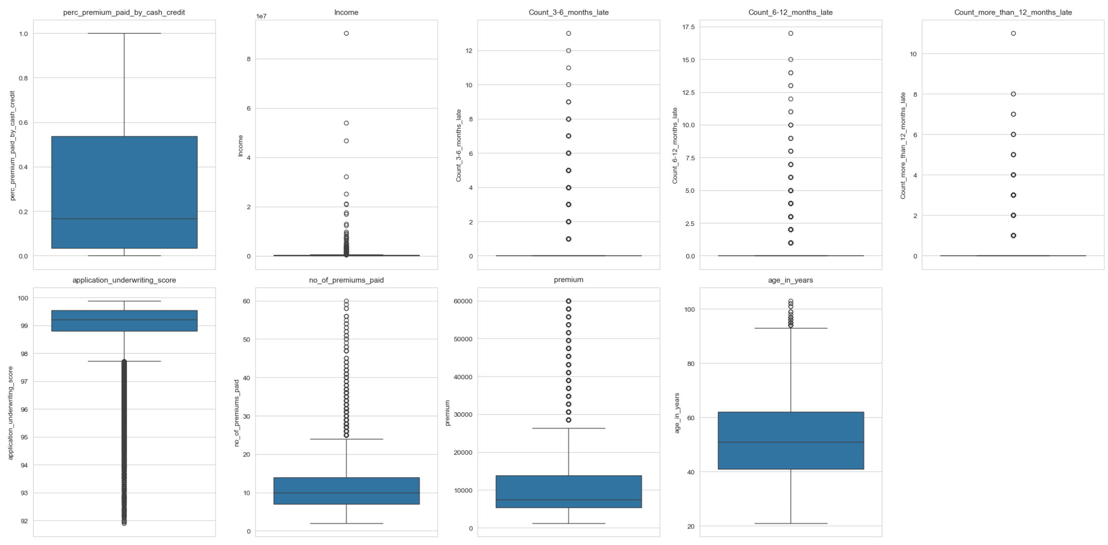

Outlier Analysis
Method Used – Interquartile Range (IQR) method applied
to all numeric features.
Rationale – Detect values that lie beyond the expected
distribution range.
Approach
Calculated Q1, Q3, and IQR for each feature
Flagged observations outside $Q1\text{–}1.5×IQR,Q3$
$+1.5×IQR$as outliers

Slide 15
Premium Outliers
IQR Upper Bound → 26,400
Outliers Detected → 4,523 rows (16 distinct values)
Pattern Observed → Structured increments (28,500 → 30,600 → … → 60,000)
Renewal Rates → Outliers: 95.49% vs Non-outliers: 93.64%
Conclusion →
These are valid premium brackets for high-value policies
No adverse impact on renewal → outliers retained

Slide 16
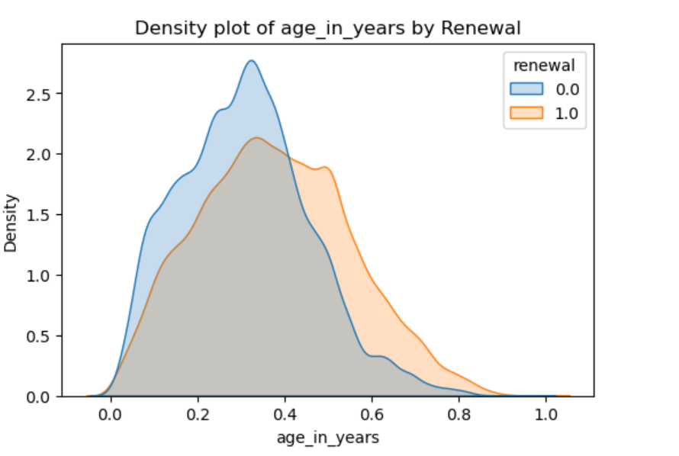
Age Outliers
IQR Upper Bound → 93.5 years
Outliers Detected → 44 records (ages 94–103)
Renewal Rates → Outliers: 95.45% vs Non-outliers: 93.74%
Interpretation →
These are realistic elderly customers, not data errors
Density plot of renewal by age shows older customers are more likely to renew
Renewal rates show no adverse effect → outliers retained
Note →
In real-world insurance, certain policy types may not be offered to very elderly customers
Since policy type is not part of our dataset, we cannot assess this interaction fully

Slide 17
Number of Premiums Paid – Outliers
IQR Upper Bound → 24.5 premiums
Outliers Detected → 1,426 rows (34 distinct values), up to 60 premiums
Renewal Rates → Outliers: 93.13% vs Non-outliers: 93.75%
Interpretation →
Outliers represent long-tenured, loyal policyholders
Renewal behavior is consistent with rest of population
Outliers retained as they provide valuable information

Slide 18
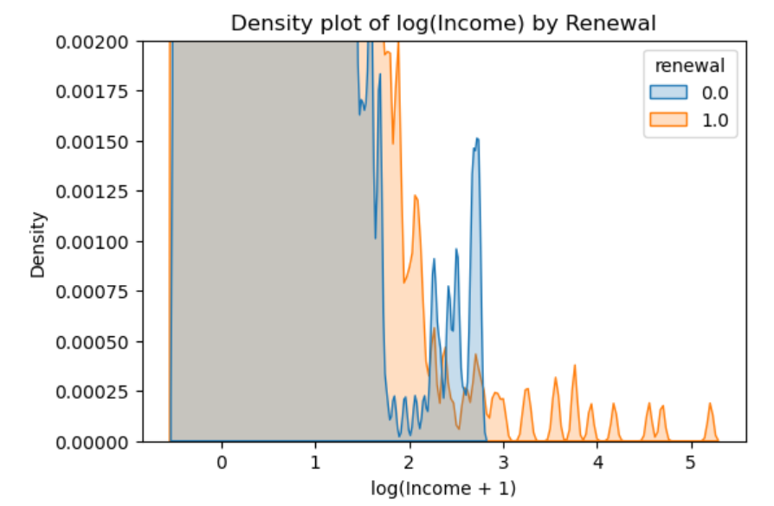
Income Outliers
IQR Bounds → –108,110 to 468,210
Outliers Detected → 3,428 rows (2,233 distinct values) up to 470,040
Renewal Rates → Outliers: 95.22% vs Non-outliers: 93.67%
Interpretation →
Outliers correspond to very high-income customers
High-income customers (right tail) show a stronger renewal tendency compared to lower-income customers.
These customers show higher renewal loyalty
Outliers retained as they are business-relevant segments

Slide 19
Late Payment Features – Outlier
Distribution
Heavily zero-inflated; most customers have no late payments, smaller subset has positive counts.
IQR Result
Both bounds = 0 → technically flags every positive count as an outlier.
Interpretation
Positive counts are not errors, but valid signals of delinquency.
Strong negative correlation with renewal → critical predictors.
Key Insight
If all missing values were imputed with 0, these columns would collapse to all zeros
effectively erasing the feature.
Correlation analysis shows these features are among the most important.
Decision
Preserve in raw form; retain positive counts; avoid blanket zero-imputation.

Slide 20
Application Underwriting Score Outliers
IQR Bounds → 97.72 to 100.64
Outliers Detected
3,381 rows (454 distinct values), including values such as 91.9, 91.96, 92.03, etc.
Renewal Rates
Outliers: 87.84% vs Non-outliers: 94.00%
Outliers were 6.16% more likely not to renew
Interpretation
Low underwriting scores reflect higher risk customers
Predictive of non-renewal behavior
Decision
Retained outliers, as they carry strong predictive signal

Slide 21
Logical Consistency Checks
Late Payments vs Premiums Paid
242 rows (~0.3%) recorded more late payments than premiums paid
Example: Customer with 2 premiums but 6 late payments
Indicates data recording issues or unrealistic behavior
Premiums Paid vs Age
Some records showed premiums paid greater than customer’s age
Unrealistic under the assumption of yearly premium cycle
Suggests potential anomalies in reporting or data entry

Slide 22
Exploratory Data Analysis (EDA)
Having addressed data quality and logical consistency,
We now focus on exploring patterns, distributions, correlations, and feature relationships
Aim → uncover signals that explain renewal vs non-renewal

Slide 23
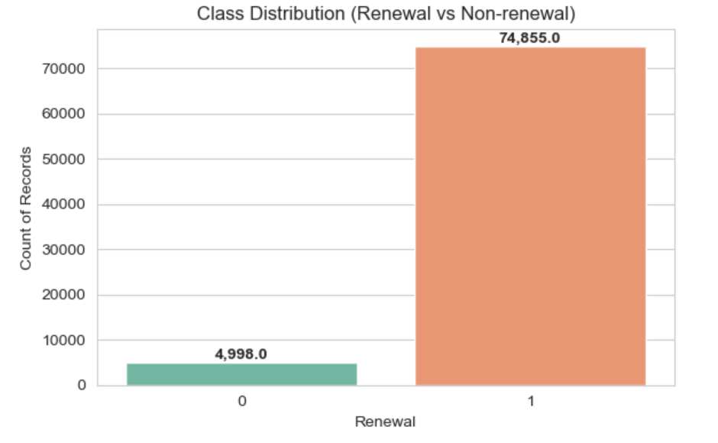
Class Imbalance
Observation → Dataset is highly imbalanced: ~93% renewals vs 7% non-renewals
Risk → Training directly would bias models toward the majority class (renewals)
Mitigation Strategies
Tree-based models → Used class weights to counter imbalance
Statistical models
Applied SMOTE/ADASYN oversampling to generate synthetic minority samples
Evaluation Metrics
Accuracy alone is misleading
Use Balanced Accuracy, F1-score, and PR-AUC to ensure performance reflects minority class capture

Slide 24
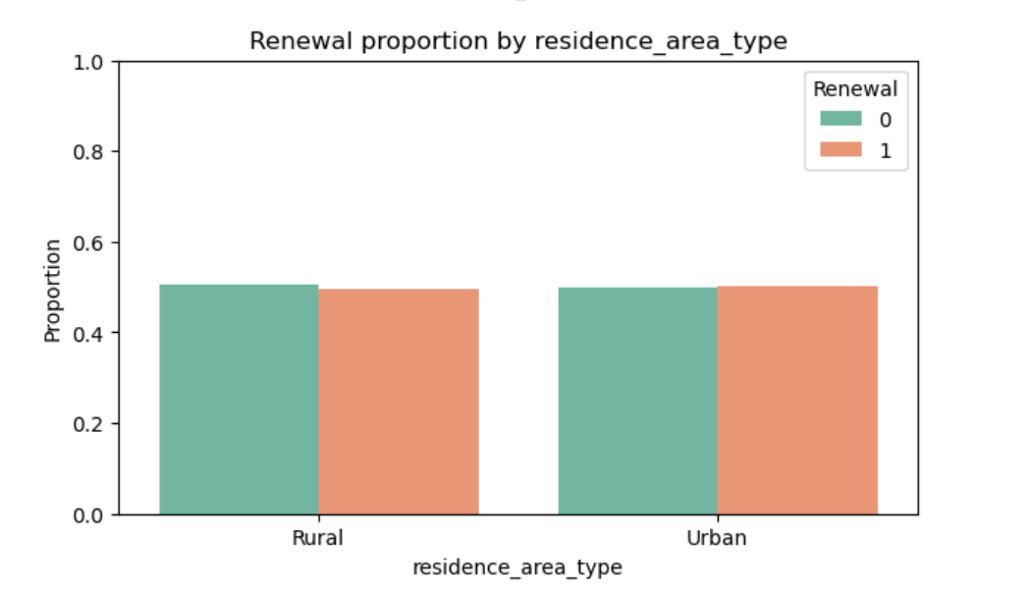
Residence Area Type
Exploratory Analysis
Renewal rates nearly identical for Urban vs Rural customers
Suggests minimal predictive power
Multivariate Interaction
Tested interactions with premium, age, income, late payments, underwriting score, and sourcing channel
Differences in renewal rates remained negligible (<3%)
Conclusion
Tree-based models → Feature can be retained (automatically down-weighted if weak)
Statistical models → Safe to drop to reduce noise and improve model stability

Slide 25
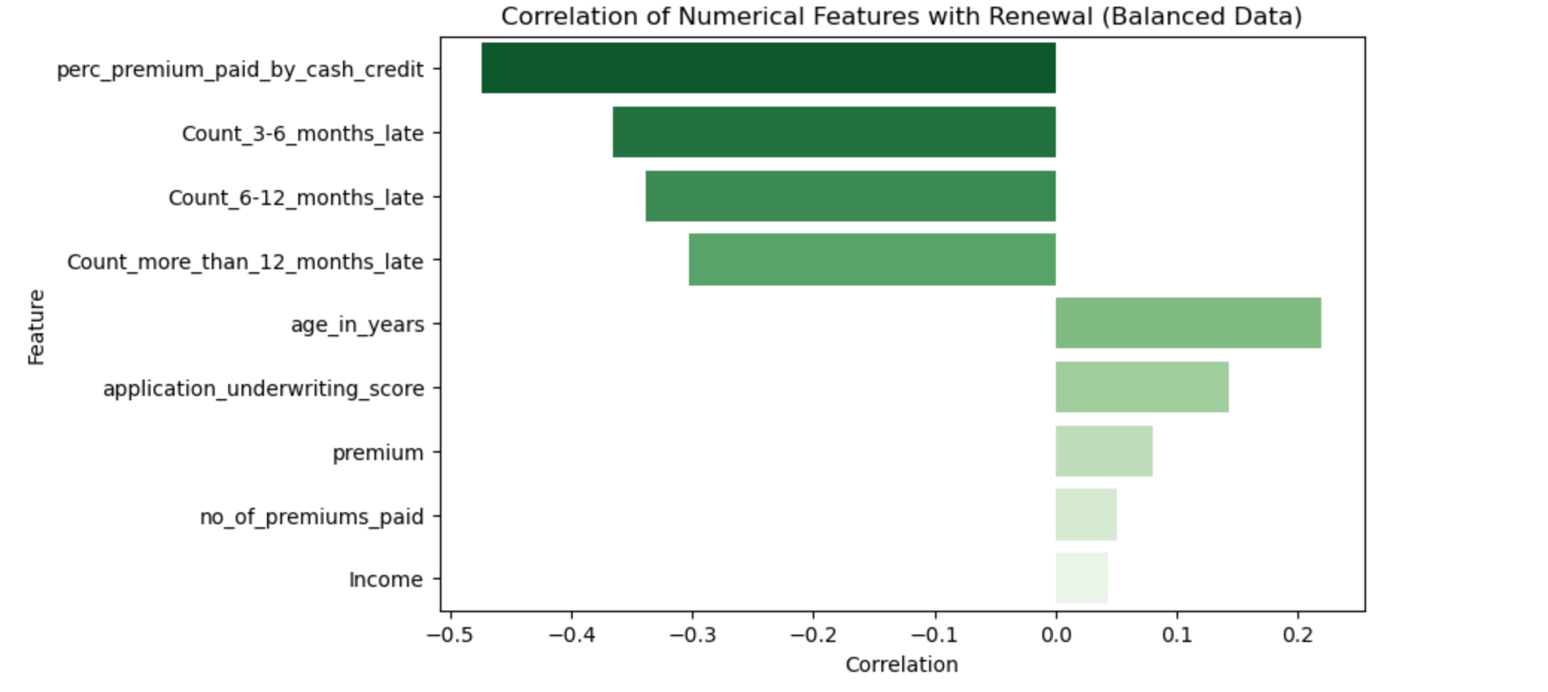
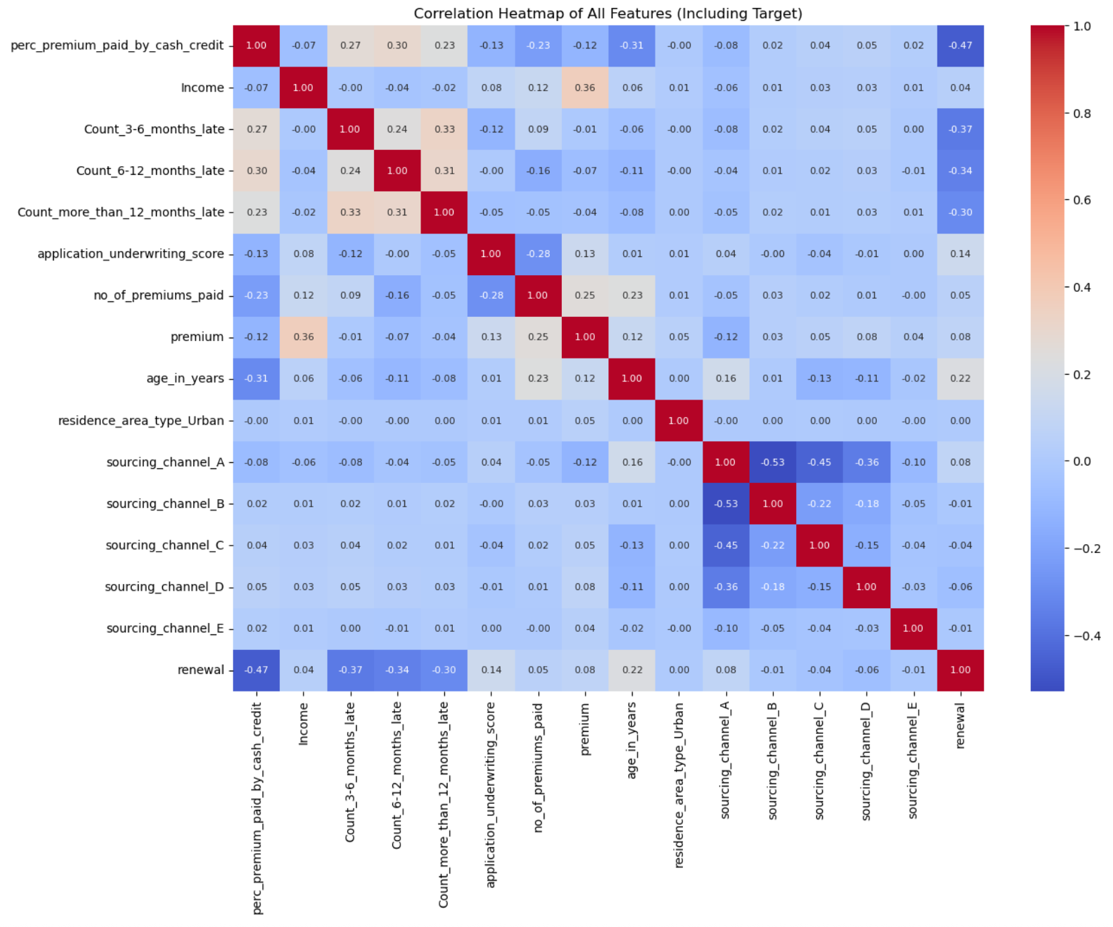
Higher late payment counts → strongly associated with non-renewal
% Premium Paid by Cash/Credit → clearer separation, with non-renewers peaking at higher values

Slide 26
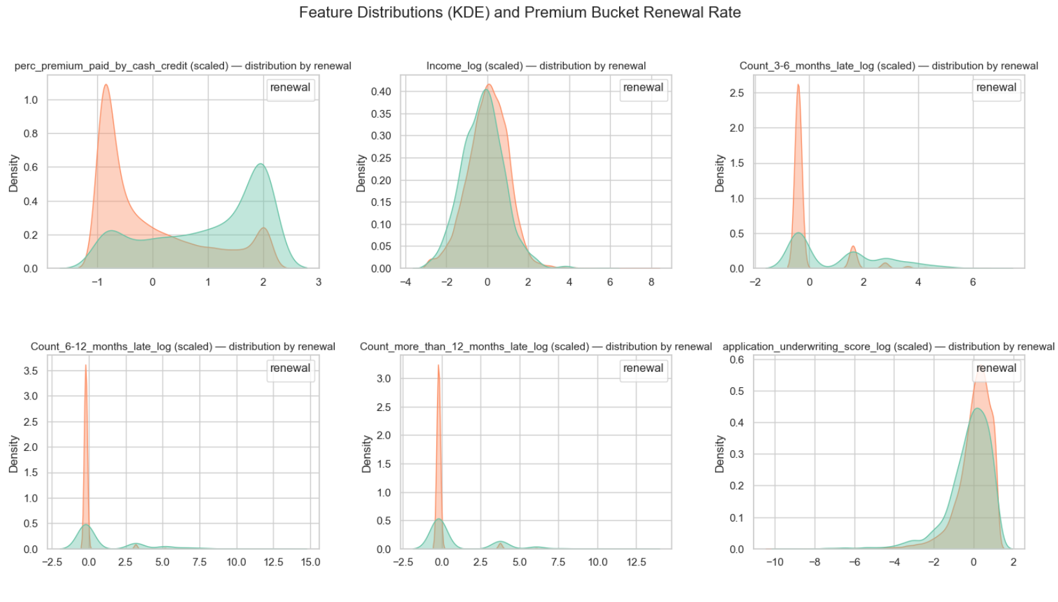
Density Plots
Heavy overlap between renewers and non-renewers across most features

Slide 27
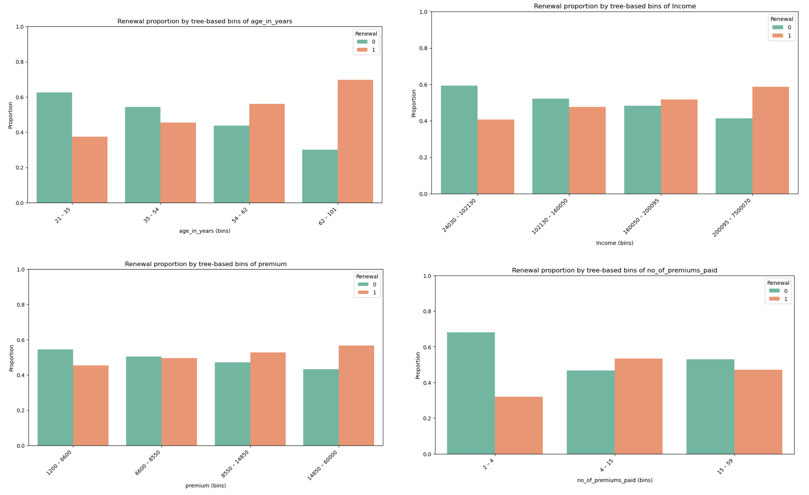
Higher income, more premiums paid, and older age → positively associated with renewal

Slide 28
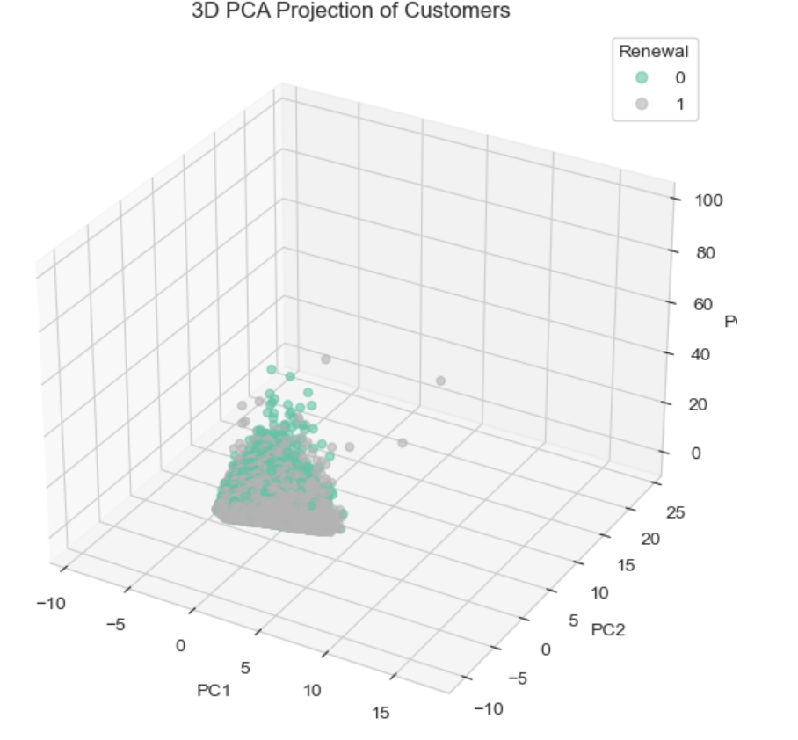
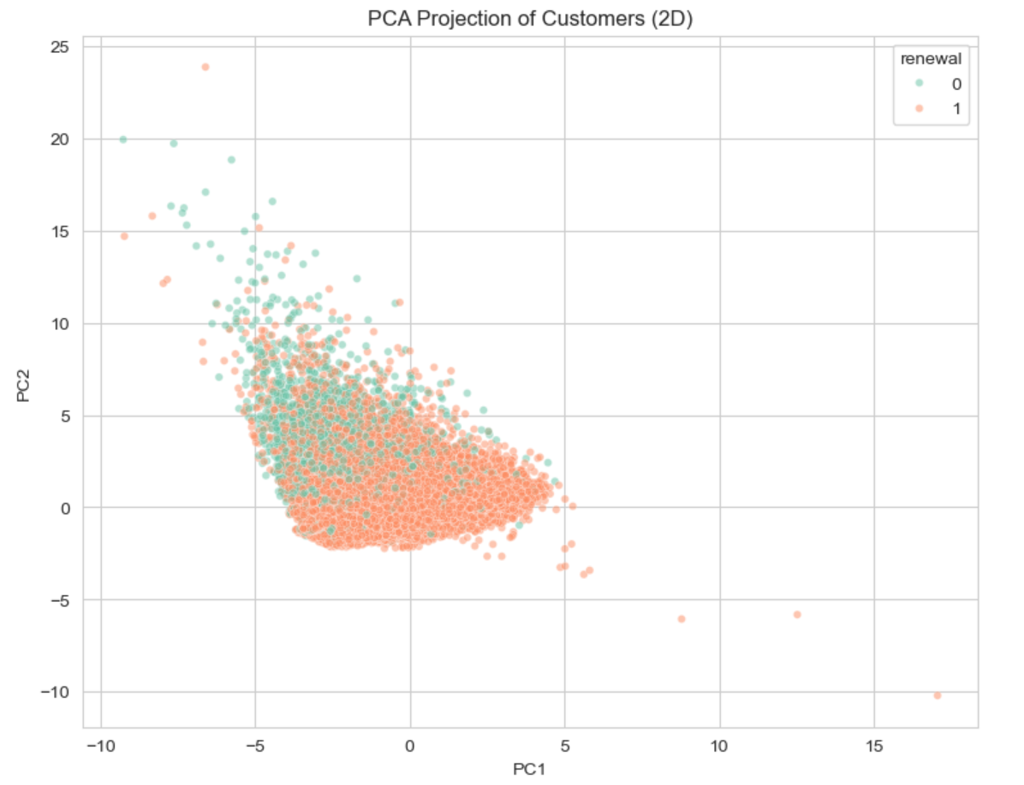
PCA Projection – Customer Renewal
2D & 3D PCA plots show substantial overlap between renewers (1) and non-renewers (0).
Indicates that dominant variance directions in the data do not cleanly separate the classes.
Renewal behavior is driven by complex, non-linear feature interactions, not simple variance.
Implication
Linear models relying only on variance (e.g., plain Logistic Regression without interactions) may underperform.
Tree-based ensembles (Random Forest, XGBoost, Gradient Boosting)
and other non-linear algorithms are better suited to capture these interactions.

Slide 29
Overall EDA Conclusions
Class Imbalance → 93% renewals vs 7% non-renewals; requires resampling/weighting
Feature Correlations →
Negative: % Premium Paid by Cash/Credit, Late Payments
Positive: Age, Underwriting Score, Premium
No single dominant predictor → predictive strength from combined weak signals
Categorical Feature (Residence Area Type) → Minimal impact on renewal, low predictive power
Density Plots → Higher income, more premiums, older customers renew more; late payments strongly linked to non-renewal
PCA Visualization → Strong overlap between classes; renewal driven by non-linear feature interactions
Modeling Implication → Tree-based ensembles best suited to capture these relationships

Slide 30
Feature Engineering (Applied)
Transformations Applied
Converted age_in_days → age_in_years for interpretability
One-hot encoding for categorical features (sourcing_channel, residence_area_type)
Normalized continuous features (Income, Premium, Age, Underwriting Score) for scale-sensitive models
Conclusion
These steps made raw data more interpretable and model-friendly
Ensured compatibility with both statistical and tree-based algorithms

Slide 31
Feature Engineering (New derived features)
New Features to Explore
Total Late Payments = Sum of 3 late payment features → captures overall delinquency
Late Payment Ratio = Total Late Payments ÷ Premiums Paid → delinquency adjusted for tenure
Premium-to-Income Ratio = Premium ÷ Income → affordability signal
Conclusion
These engineered ratios may strengthen predictive signal
Especially useful for statistical models that don’t capture interactions automatically

Slide 32
Modeling Summary
Objective The goal is to build a robust classification model to predict the likelihood of non-renewal (customer churn), enabling insurers to proactively engage at-risk customers and improve retention.
Modeling Approach We are following a consistent pipeline across all models:
Preprocessing and feature engineering (age conversion, one-hot encoding, normalization)
Addressing class imbalance (Class Weights, SMOTE/ADASYN)
Splitting dataset using train_test_split() with stratification to preserve class ratios
Training multiple classifiers: Logistic Regression, Random Forest, XGBoost, Neural Networks
Evaluating models with metrics suited for imbalance and churn capture
Evaluation Metrics
Accuracy is avoided due to imbalance (~93% renewals vs 7% non-renewals)
Focus is on:
Recall (priority) → to maximize capture of churners (non-renewals)
F1-score → to balance recall & precision
PR-AUC → to ensure robustness under imbalance

Slide 33
Models Trained & Evaluated(Untouched Data)
Model | Accuracy | Recall (Class 0) | Recall (Class 1) | F1 (Class 0) | F1 (Class 1) | ROC-AUC | Verdict / Notes
Logistic Regression | 0.9381 | 0.123 | 0.9926 | 0.1994 | 0.9678 | 0.8319 | Interpretable & fast baseline. Moderate recall for Class 0.
XGBoost | 0.9354 | 0.145 | 0.9882 | 0.2195 | 0.9663 | 0.8205 | Best F1 on Class 0, fast training, well-balanced.
Gradient Boosting | 0.9376 | 0.124 | 0.9920 | 0.1994 | 0.9676 | 0.8452 | Best ROC-AUC, great balance across metrics.
Random Forest | 0.9376 | 0.111 | 0.9928 | 0.1821 | 0.9675 | 0.8260 | Stable, good fallback, weaker on Class 0 recall.
SVM | 0.9374 | 0.000 | 1.0000 | 0.0000 | 0.9677 | 0.5066 | Ignores Class 0 entirely — not usable for churn detection.

Slide 34
Models Trained & Evaluated(over sampled data)
Model | Accuracy | Precision (Class 0) | Recall (Class 0) | F1 (Class 0) | Recall (Class 1) | ROC-AUC | Notes
Logistic Regression | 0.9378 | 0.5146 | 0.123 | 0.1985 | 0.9923 | 0.829 | Interpretable, very high recall on Class 1, weak on minority (Class 0)
XGBoost | 0.9354 | 0.4517 | 0.145 | 0.2195 | 0.9882 | 0.821 | Best balance between recall & F1, good generalization
Gradient Boosting | 0.9376 | 0.5082 | 0.124 | 0.1994 | 0.992 | 0.845 | Strong ROC-AUC, still weak Class 0 recall
Random Forest | 0.9376 | 0.5068 | 0.111 | 0.1821 | 0.9928 | 0.826 | Robust baseline, strong Class 1 performance
SVM | 0.9374 | 0 | 0 | 0 | 1 | 0.507 | Completely ignored Class 0, not suitable for imbalanced data

Slide 35
Modeling Considerations
Outliers in features (Premium, Income, Age, Tenure, Underwriting Score) were found to be valid
business cases → retained
Statistical models (e.g., Logistic Regression) may underperform due to sensitivity to outliers and linear assumptions
Tree-based ensemble models (Random Forest, XGBoost, Gradient Boosting) are better suited → can handle outliers, class imbalance, and non-linear feature interactions
We still implemented multiple models for benchmarking and fairness, but tree-based approaches are expected to perform best

